Slide 1
Department of Computer Science and Technology
21SF02 Mini Project I : : Final Review
ACADEMIC YEAR: 2023 - 2024 (Even)
06/06/2024

Slide 2
Project Guide
Batch Details
Batch NO - 7
Ms.K.Sakthi Priya , M.TECH., AP/CT
Project Members
NAVEENA M - 717822S134
SEHNAAZ I T - 717822S146
SOWMIYA K - 717822S153

Slide 3
Title
Title : A Geographical Information System For E-Waste Facility Locator.
Domain: Ministry of Environment

Slide 4
Problem Identification
Source : Smart India Hackathon
Problem Statement ID : 1392
Description : Website that tells you the location of the nearest e-waste collection and recycling facility. Offers educational pop-ups on the harmful components of your e-waste and their effects on the environment and human health if not disposed correctly. There could be an option to input the model of your old device and earn credit points relative to the amount of precious metals recovered from the device if disposed correctly.
Domain : Ministry of Environment

Slide 5
Problem Identification
Technological advancement has made our lives better, it has also given rise to a critical issue called electronic waste, or e-waste.
E-waste, which includes old or broken electronics, is hazardous to both the environment and people's health.
E-waste improperly disposed of can cause pollution, exposure to hazardous materials, and long-lasting ecological harm.
The significance of this challenge increases as electronic devices become more pervasive in our lives.

Slide 6
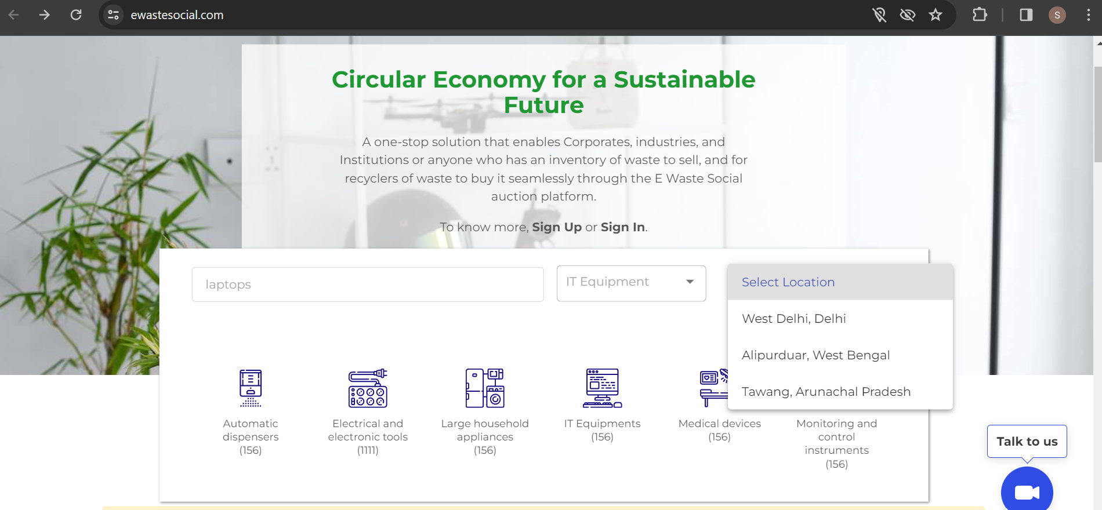
Existing System / Application
1.https://ewastesocial.com/
DISADVANTAGE:
Limited Coverage
Inadequate Public Awareness

Slide 7
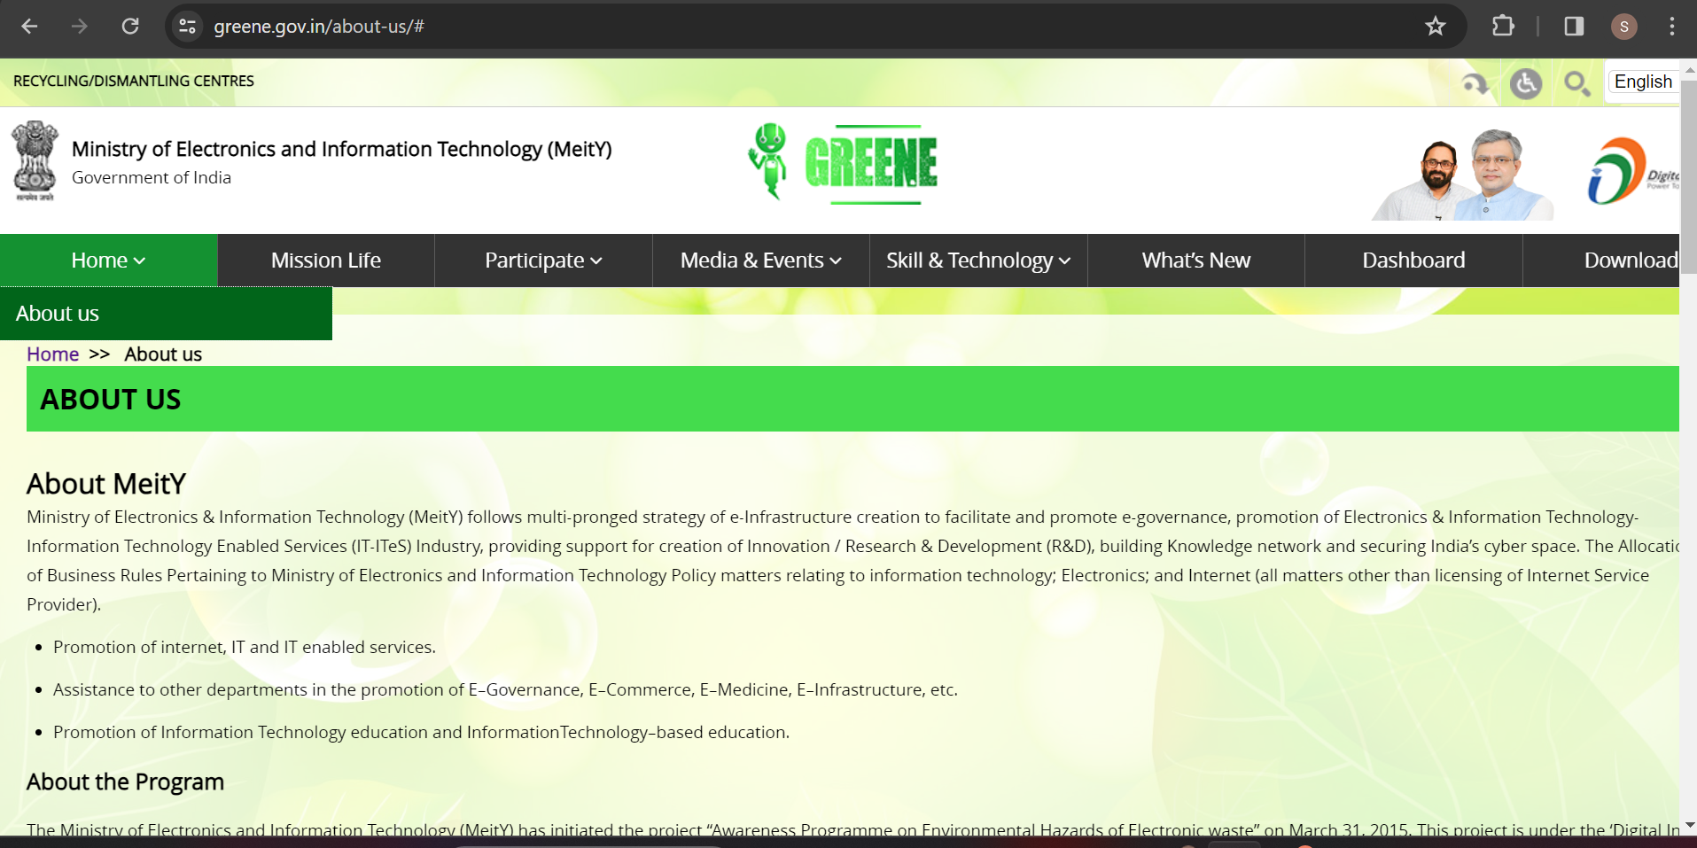
Existing System / Application
2.https://greene.gov.in/
DISADVANTAGE:
It only covers 10 identified states viz. Madhya Pradesh, Uttar Pradesh, Jharkhand, Orissa, Goa, Bihar, Pondicherry, West Bengal, Assam and Manipur

Slide 8
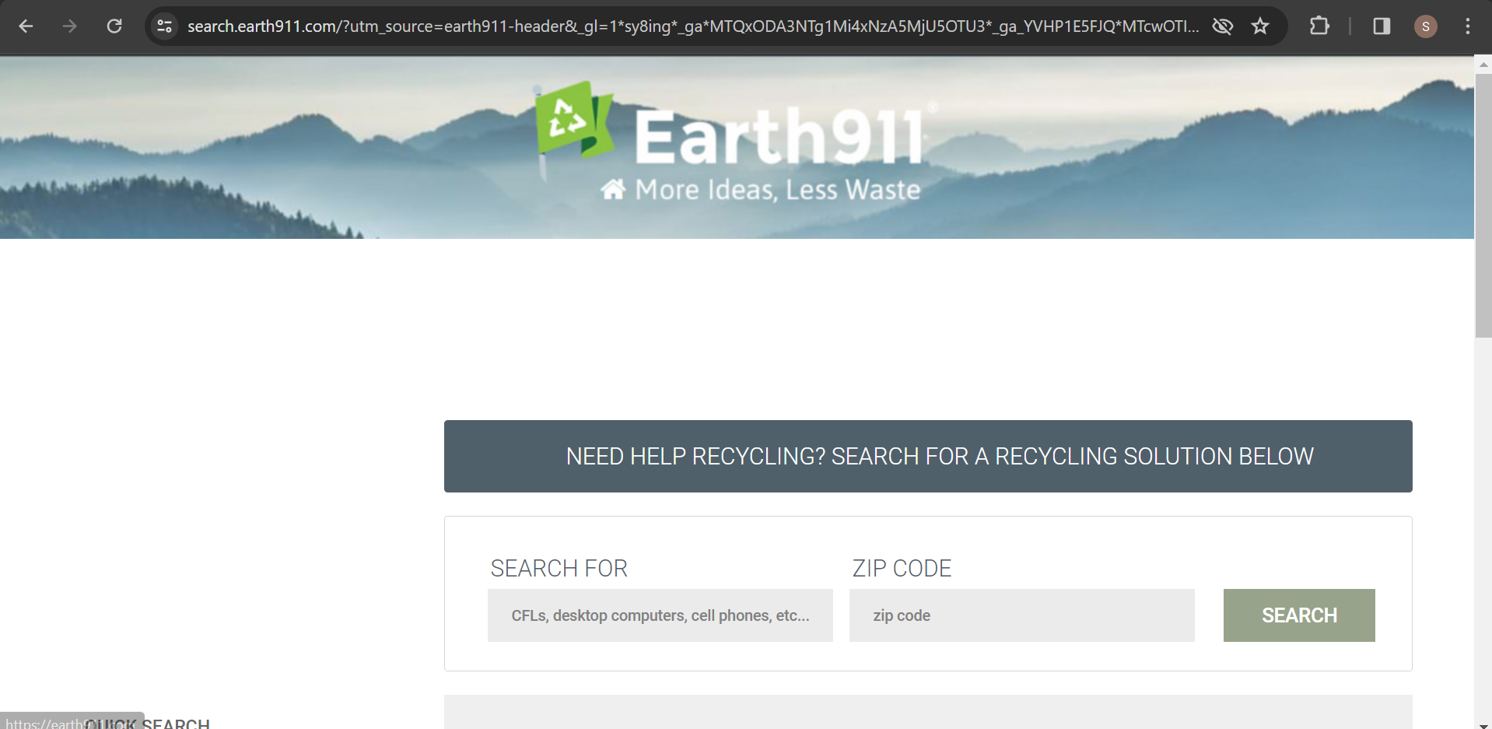
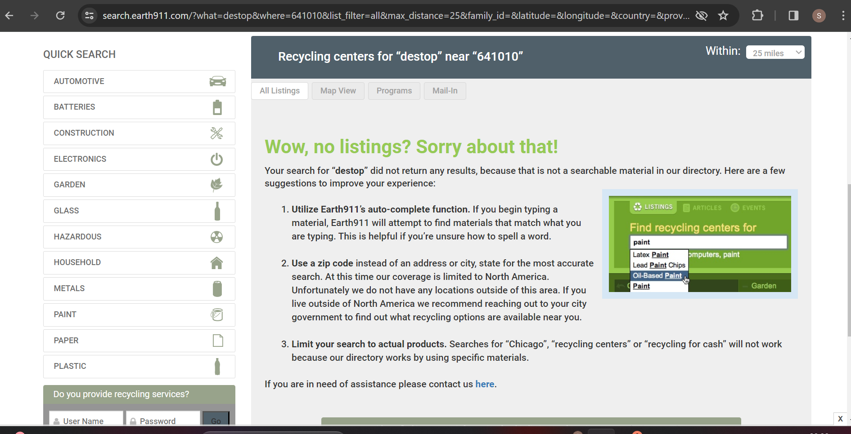
Existing System / Application
3. https://earth911.com/
DISADVANTAGE:
It uses zip code instead of pin code or address
It only covers areas in North America

Slide 9
Software and Hardware Requirements
HARDWARE SPECIFICATION
PROCESSOR : INTEL CORE 5
MEMORY : 8 GB
STORAGE : 256 GB
SOFTWARE SPECIFICATION
OPERATING SYSTEM : WINDOWS 11
IDE : VISUAL STUDIO CODE
FRONTEND : HTML5, CSS , JAVASCRIPT
VERSION CONTROL : GIT

Slide 10
Analysis and Explanation of Identified Problems
IDENTIFIED PROBLEM : Lack of Awareness
EXPLANATION: Many people are unaware of e-waste facilities in their area or how to properly dispose of their electronics.
SOLUTION : Increase public education and outreach efforts to raise awareness about the existence and accessibility of e-waste facilities. This could involve community workshops, advertising campaigns, or school programs to inform people about the importance of proper e-waste disposal and how to use the facility locator

Slide 11
Analysis and Explanation of Identified Problems
IDENTIFIED PROBLEM: Limited Accessibility
EXPLANATION: Some individuals may have difficulty accessing e-waste facilities due to limited availability or geographic constraints.
SOLUTION : Expand the network of e-waste facilities, particularly in underserved areas, and implement mobile collection events or pickup services to improve accessibility for all community members. Additionally, consider partnerships with local businesses or community centers to provide convenient drop-off locations.

Slide 12
Analysis and Explanation of Identified Problems
IDENTIFIED PROBLEM: Inefficient Facility Information
EXPLANATION: Existing e-waste facility locators may provide incomplete or outdated information, leading to frustration and confusion among users.
SOLUTION : Regularly update and maintain facility information to ensure accuracy and reliability. Implement user-friendly interfaces and feedback mechanisms to improve user experience and satisfaction.

Slide 13
Module Identification and Description
USER INTERFACE MODULE:
This module handles the user interaction with the e-waste facility locator system. It includes components such as information about E-waste , proper disposal , Why data destruction matters, Education and awareness , searching a location, displaying the facility , and user feedback functionalities.
Web Interface: Designed using HTML, CSS, and JavaScript to provide a userfriendly layout.
Information on E-waste: Provides information on Proper management and recycling of E-waste are crucial to prevent environmental pollution
Interactive Map: Integrates with GIS to display facility locations and relevant geographic data.

Slide 14
Module Identification and Description
2.GIS AND MAPPING MODULE: This module uses Geographic Information System (GIS) technology i.e LocateStore to offer mapping features.
Facility Mapping: Shows the locations of E-waste facilities on an interactive map.
Displays Routes: Displays the routes to E-waste facilities.

Slide 15
Module Identification and Description
3.SEARCH AND FILTER MODULE
It facilitates the search and filtering functionalities within the e-waste facility locator system, allowing users to find relevant facilities based on their location preferences.
Search and Filter Tools: Enables users to search for facilities based on location, type of e-waste, and other criteria. Filtering Options: Allowing users to narrow down and display only specific E-waste facilities based on criteria such as City, Pincode, District. Interactive Map: Integrates with LocateStore Website to display facility locations.

Slide 16
Module Identification and Description
4. FEEDBACK AND REVIEW MODULE
This module allows users to provide feedback and reviews on the E-waste facility locator, enhancing service quality through community input.
Review Submission: Users can write and submit detailed reviews.

Slide 17
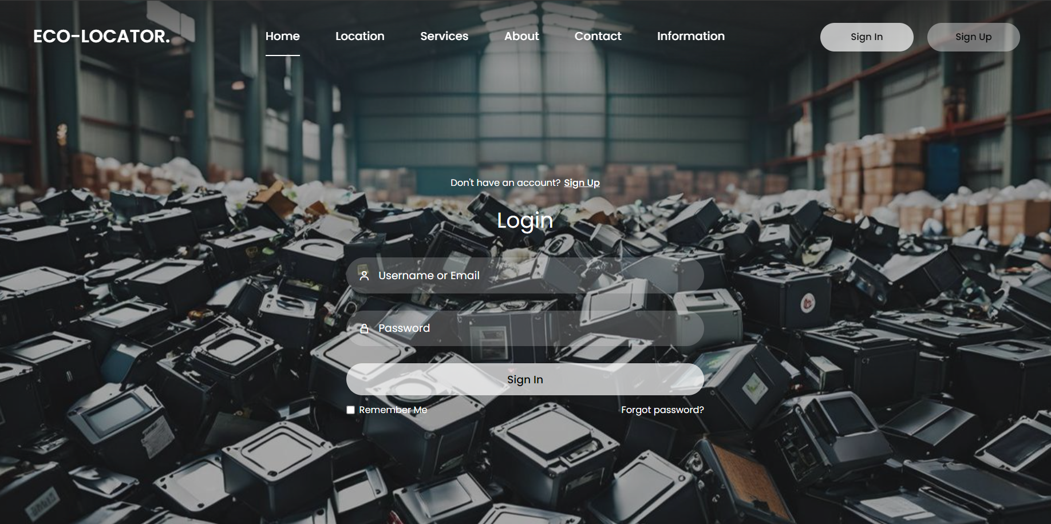
User Interface Design
LOGIN PAGE

Slide 18
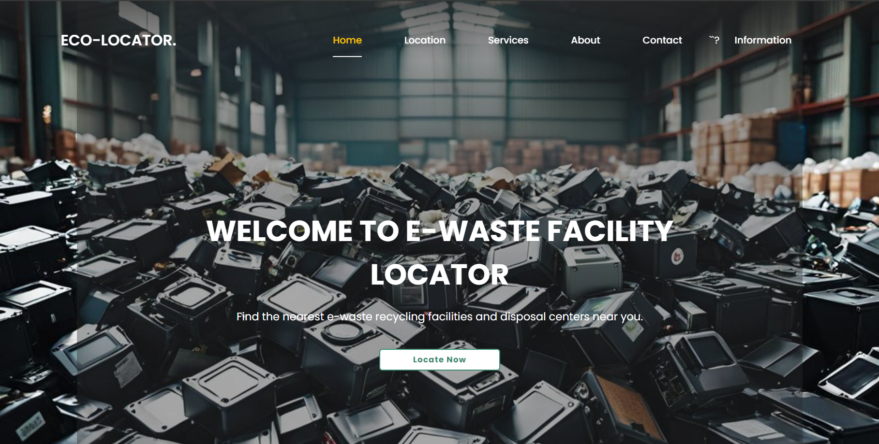
User Interface Design
HOME PAGE

Slide 19
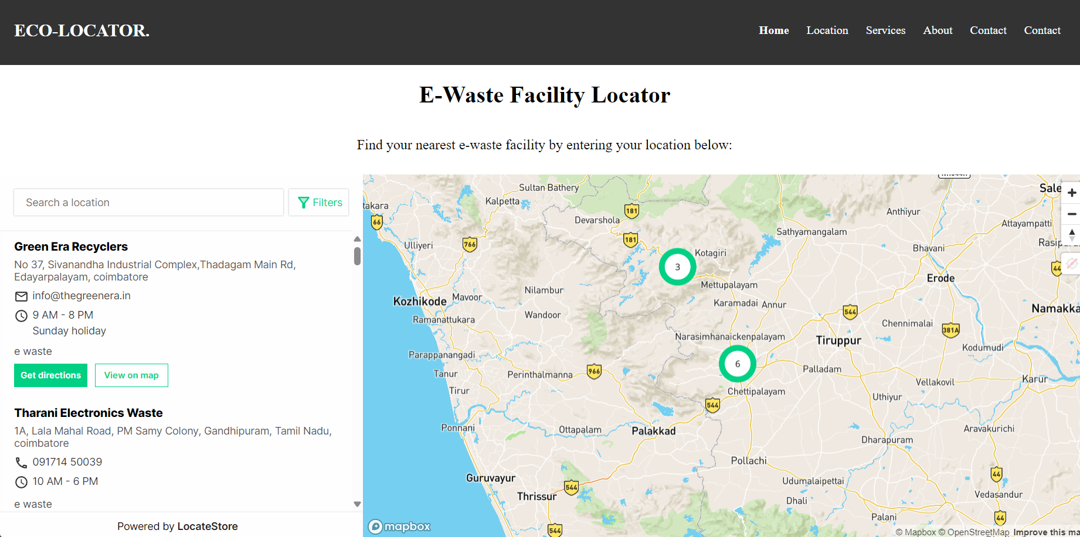
User Interface Design
LOCATION PAGE

Slide 20
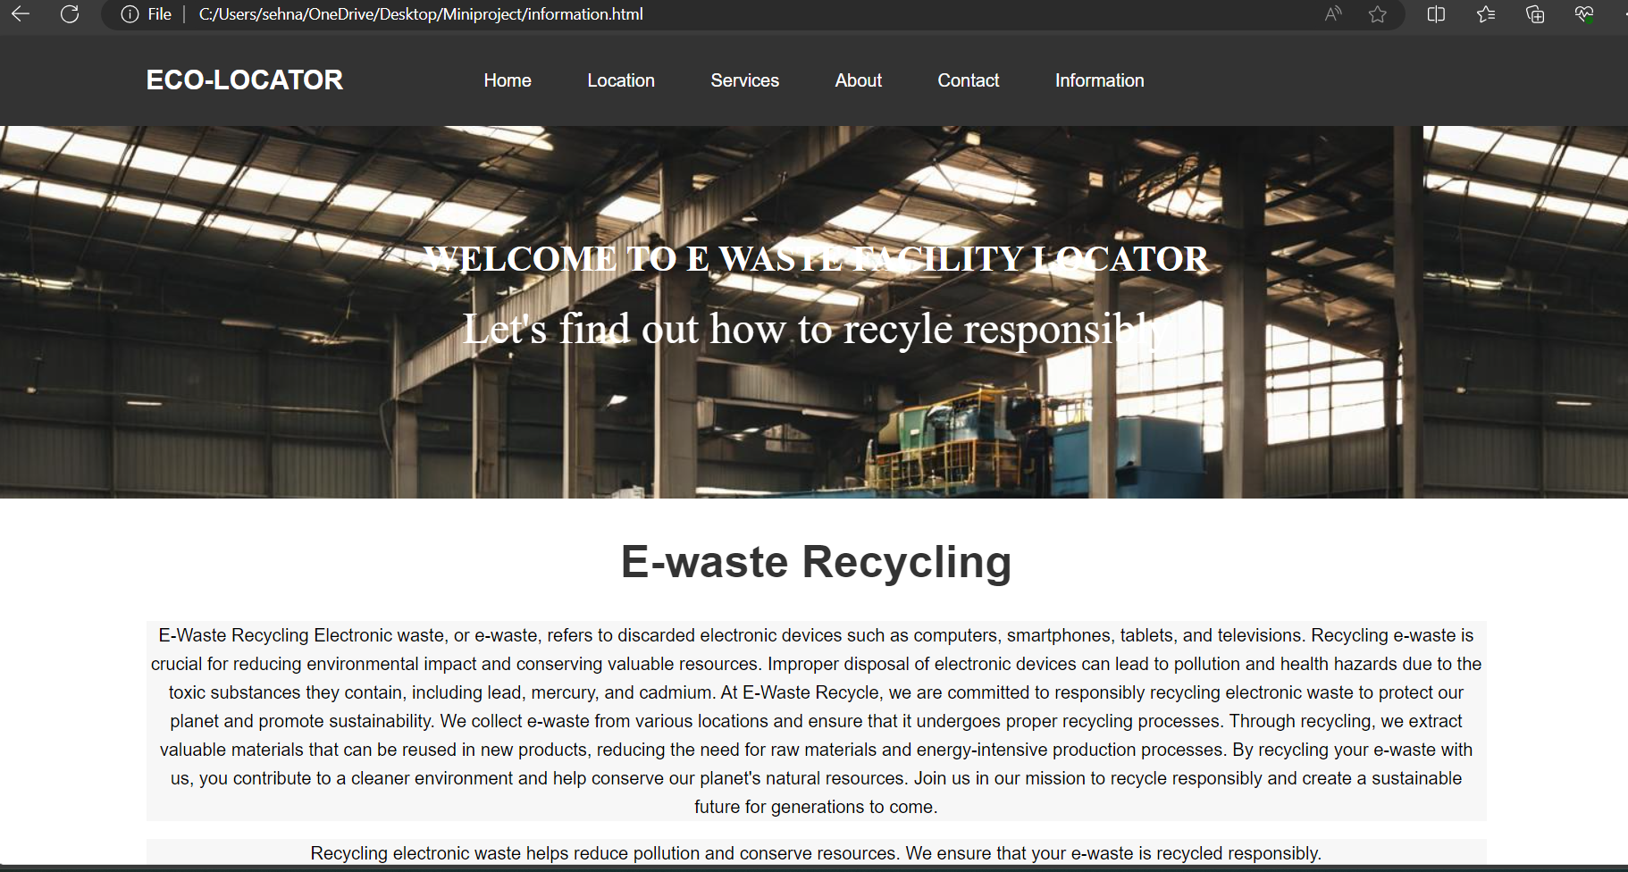
User Interface Design
INFORMATION PAGE

Slide 21
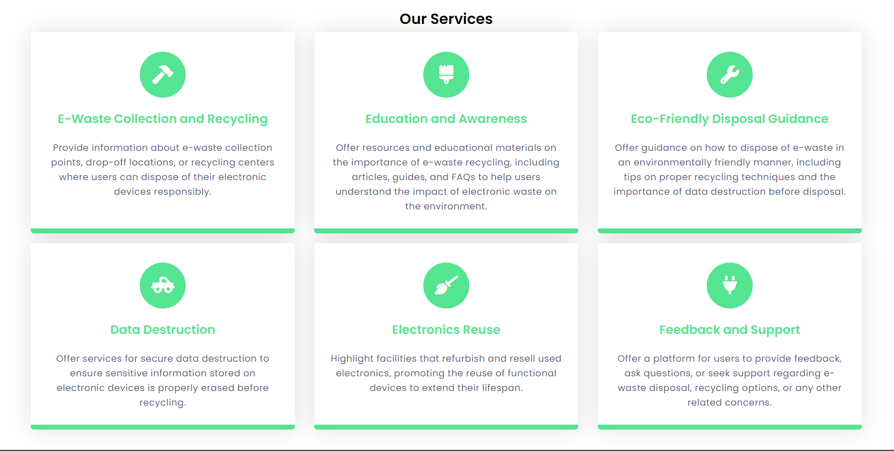
User Interface Design
SERVICES PAGE

Slide 22
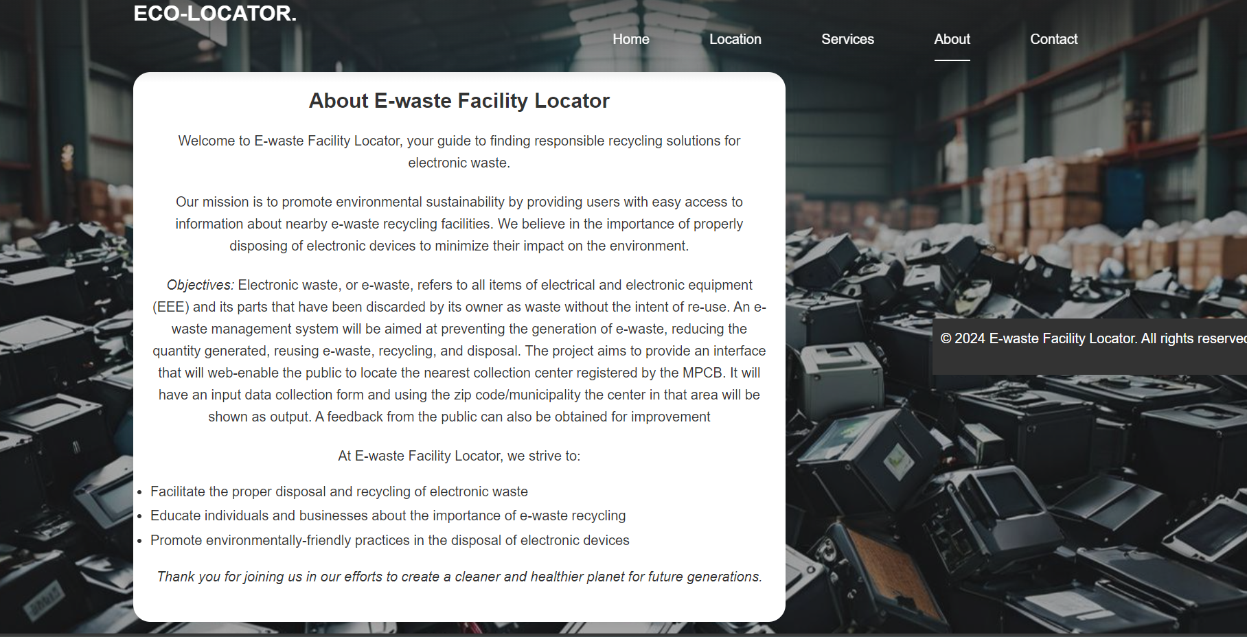
User Interface Design
ABOUT PAGE

Slide 23
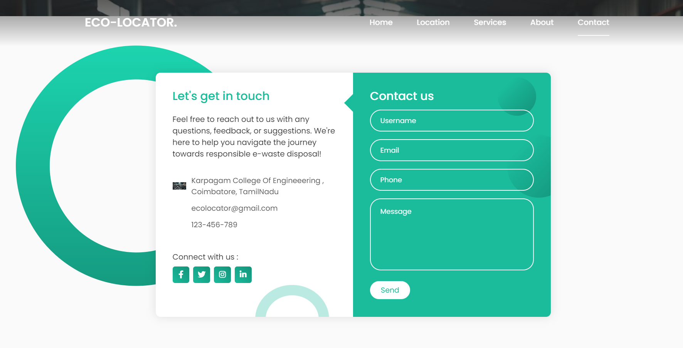
User Interface Design
CONTACT PAGE

Slide 24
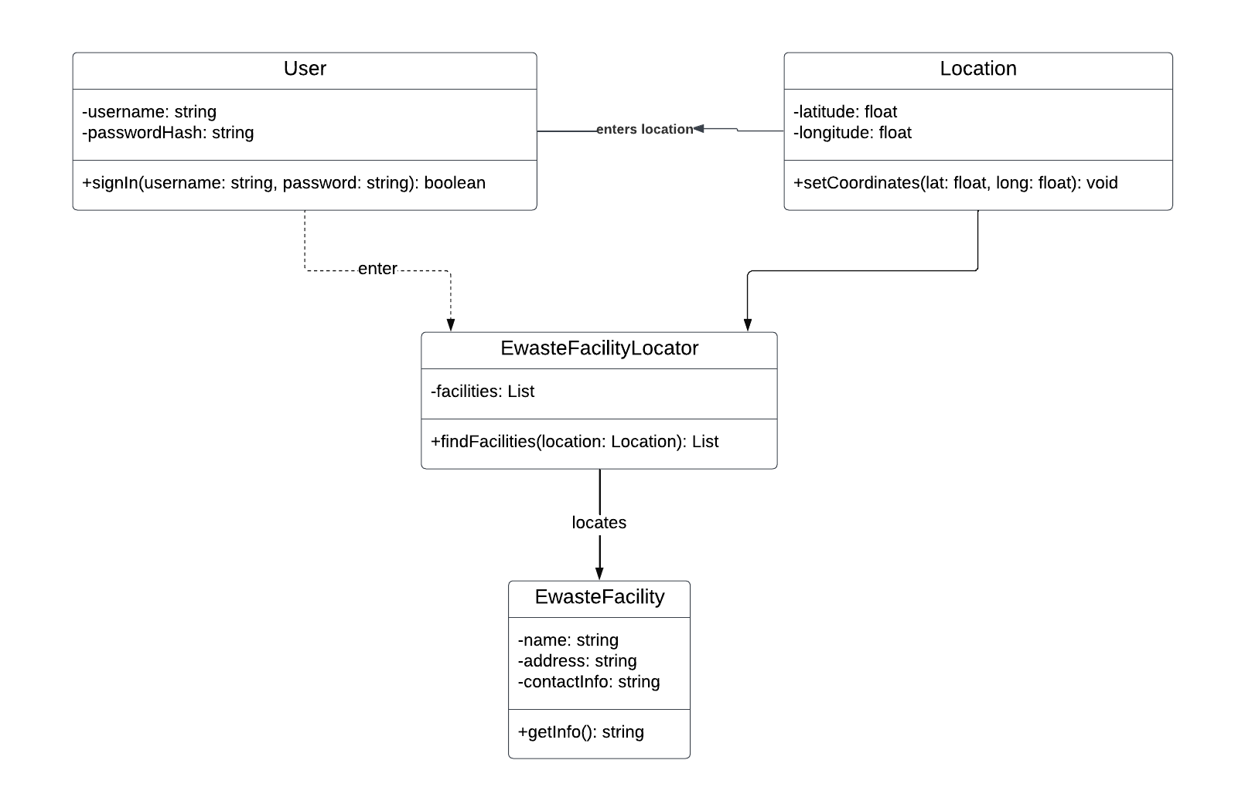
UML / System Flow Diagram

Slide 25
Test Cases
USER INTERFACE TESTING:
Test Case 1: Ensure the Locate button is visible on the homepage.
Result: The Locate button is visible and correctly placed on the homepage.
Test Case 2 : Verify clicking the "Search" button triggers the search function.
Result: The search results are displayed based on the user’s query.
Test Case 3 : Validate that entering an pincode displays the location.
Result: The location is shown when the pincode is entered.

Slide 26
Test Cases
GIS AND MAPPING TESTING :
Unit tests for the GIS and Mapping module ensure the map and geographic data render accurately. Tests include verifying that the map initializes at the correct location and that facility markers are placed correctly.
Test Case 1 : Verify the map initializes at the correct location.
Result: The map loads with the correct geographic view.
Test Case 2: Ensure facility markers are placed accurately on the map.
Result : Facility markers are placed correctly using coordinates.
Test Case 3: Verify that the route provides accurate directions.
Result: The route provided is correct and accurate.

Slide 27
Conclusion
The E-Waste Facility Locator (EWFL) project aims to provide a comprehensive, user-friendly platform for locating e-waste disposal and recycling facilities. The EWFL ensures reliability, accuracy, and security across all modules. The UI and GIS functionalities are tested to provide accurate mapping experience. Operational hours updates keep users informed about facility statuses, and the user management module secures user data and manages access rights effectively. Feedback mechanisms, educational resources about E-waste , and providing valuable insights and promoting responsible e-waste disposal. The EWFL platform helps in fostering a sustainable environment by making E-waste disposal more accessible and efficient.

Slide 28
Future Work
As the E-Waste Facility Locator (EWFL) continues to develop and improve, several future enhancements can be implemented to further increase its functionality, user experience, and impact on environmental sustainability.
Expanding the search and filtering options to include more specific criteria such as types of e-waste, facility certifications, and additional services offered (e.g., pickup services, data destruction) can provide users with more helpful results.
Developing a dedicated mobile app for both iOS and Android platforms can improve accessibility and convenience for users, allowing them to locate e-waste facilities on the go and receive real-time notifications.
Collaborating with electronics manufacturers and retailers to include E-waste facility information directly in their product packaging or customer support can raise awareness and increase the usage of the platform.
.

Slide 29
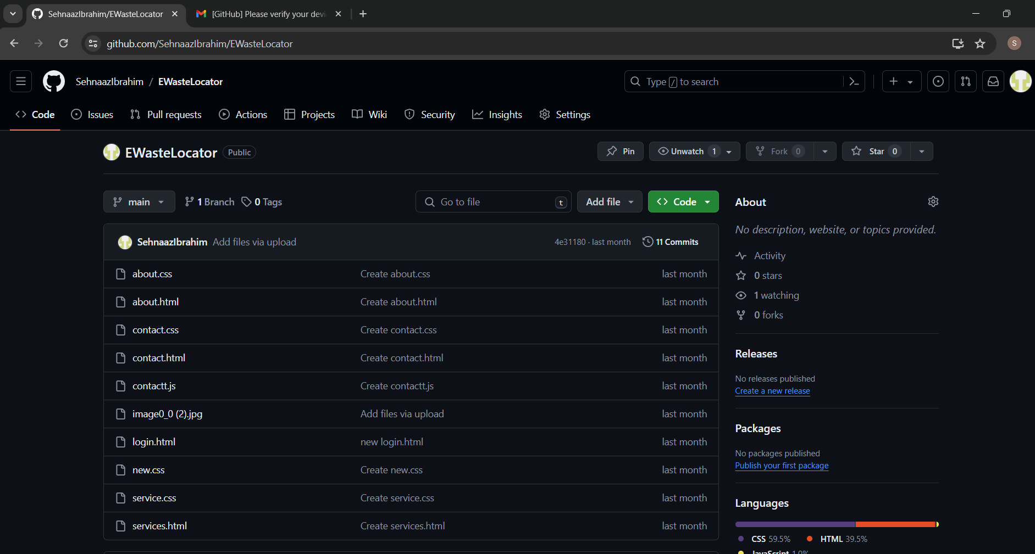
GitHub Repository Link
Repository Link: https://github.com/SehnaazIbrahim/EWasteLocator

Slide 30
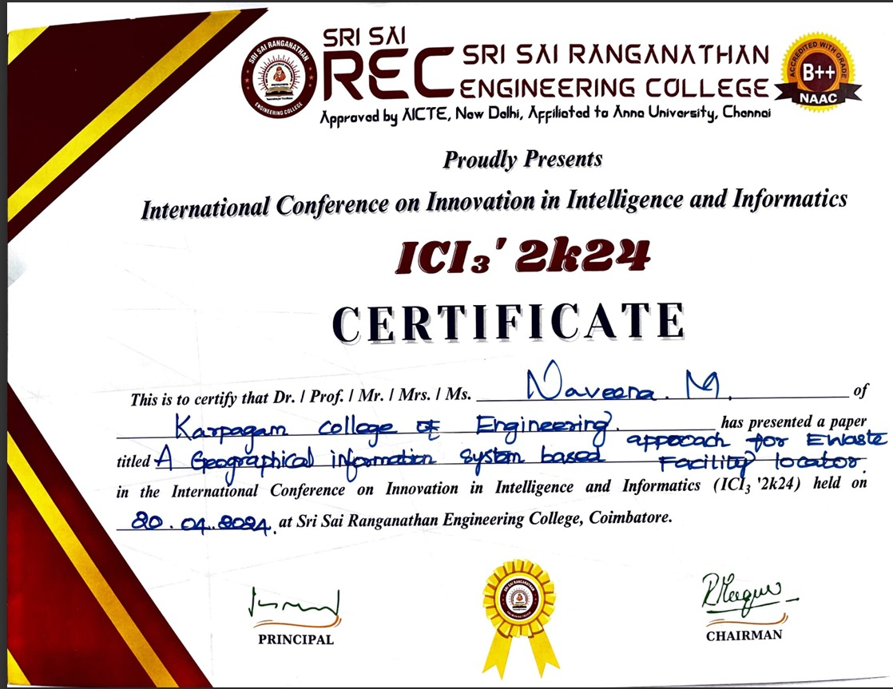
Conference Certificate(s)
717822S134- NAVEENA M

Slide 31
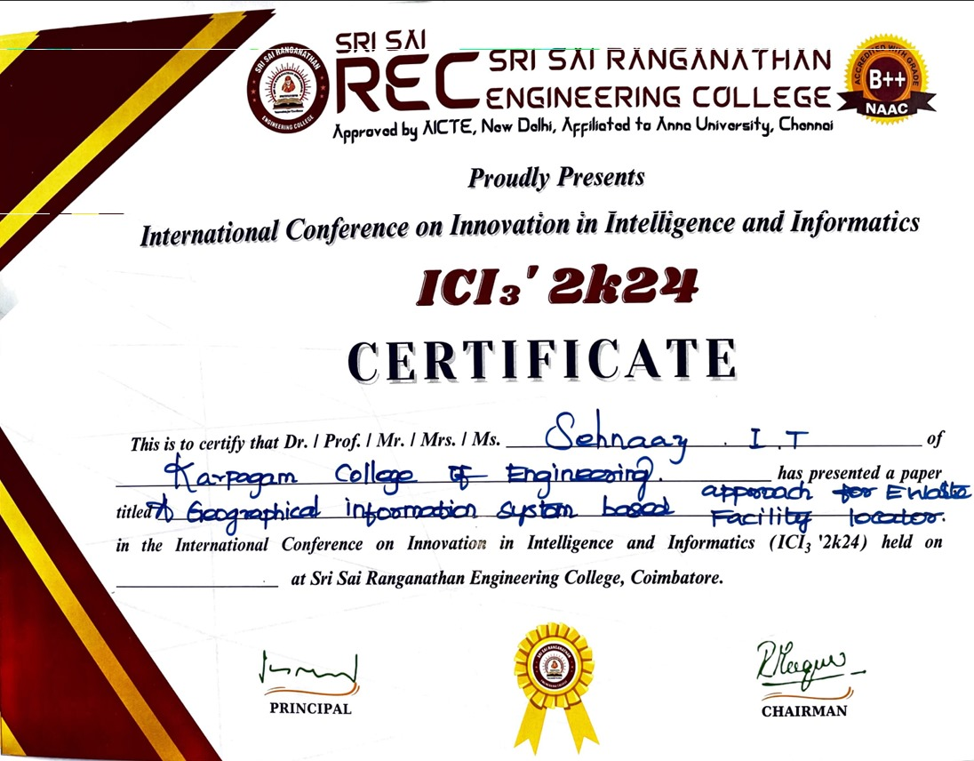
Conference Certificate(s)
717822S146- SEHNAAZ I T

Slide 32
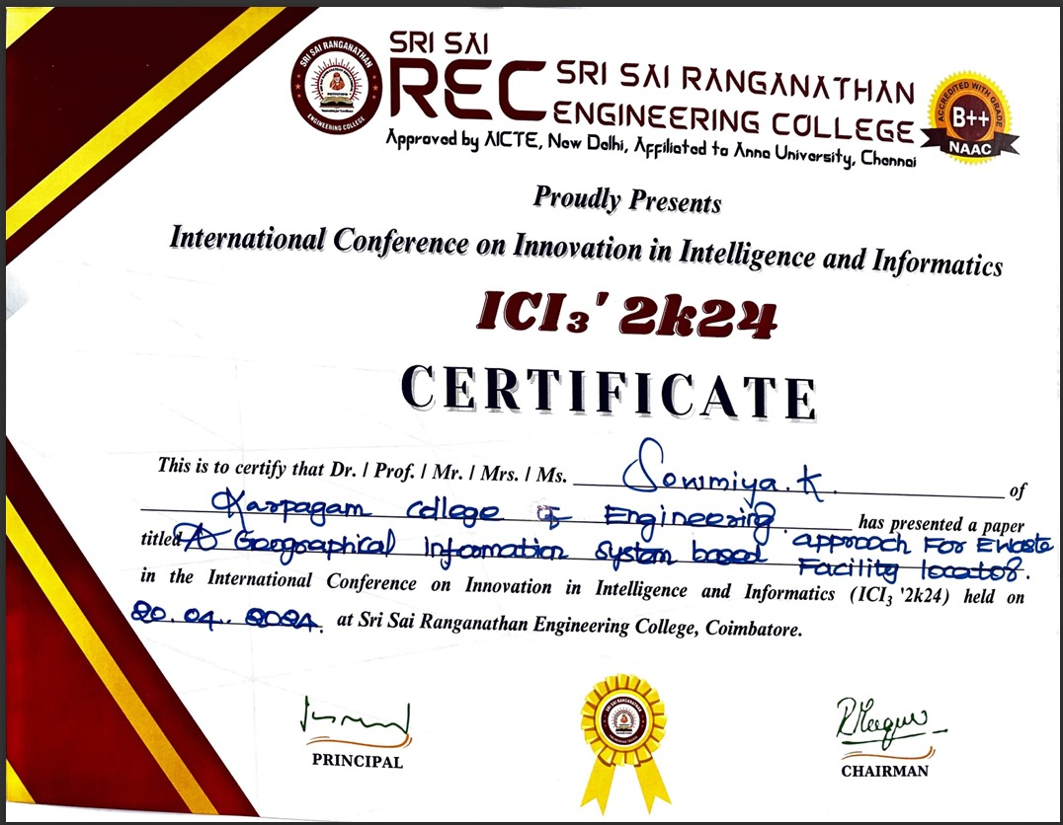
Conference Certificate(s)
717822S153- SOWMIYA K

Slide 33
REFERENCES
Book References:
1.Hester, R. E., & Harrison, R. M. (Eds.). (2013). Electronic Waste Management. Royal Society of Chemistry.
2.Goodship, V., & Stevels, A. (Eds.). (2012). Waste Electrical and Electronic Equipment (WEEE) Handbook. Woodhead Publishing.
3.Veit, H. M., & Bernardes, A. M. (2015). Electronic Waste: Recycling Techniques. Springer.
4.Johri, R. (Ed.). (2008). E-Waste: Implications, Regulations, and Management in India and Current Global Best Practices. The Energy and Resources Institute (TERI).
Web References:
1.Earth911. (n.d.). Recycling Locator. Retrieved from https://search.earth911.com/
2.e-Stewards. (n.d.). Find a Recycler. Retrieved from https://www.e-stewards.org/find-a-recycler/
3.Sustainable Electronics Recycling International (SERI). (n.d.). R2 Certified Facilities Locator. Retrieved from https://sustainableelectronics.org/recyclers/
4.Call2Recycle. (n.d.). Recycling Locator. Retrieved from https://www.call2recycle.org/locator/

Slide 34
Thank you

